Slide 1
Freedom of expression for workers – justifications (and why they matter)
Guy Davidov
Hebrew University of Jerusalem

Slide 2
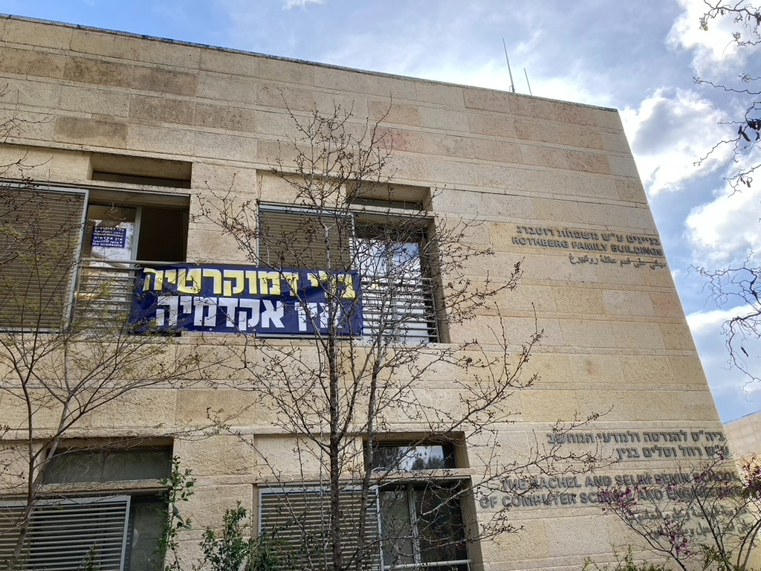

Slide 3
The traditional justifications
Understanding the justifications is necessary for purposive interpretation + policy-making
Three longstanding justifications for freedom of expression
Search for the of truth (“marketplace of ideas”)
Part of democratic self-government
Self-fulfillment, autonomy
Developed in the academic literature, also appear in judgments around the world, and explicitly in the Constitution of Norway(!)

Slide 4
Contextual interpretation
Purposes are often the same across time, place and circumstances, but context should also be taken into account
Dieter Grimm: “The goal of interpretation is to fulfil the purpose of the norm to the utmost extent under changing conditions… The consequence is a three-dimensional understanding of constitutional norms: text plus purpose plus context”
In particular: ensuring that a right is effective/meaningful in the specific context/social reality

Slide 5
Freedom of expression in employment relations
Context: inequality of power + employment relationship is highly important for the worker
Right to free speech should be interpreted in this light (Virginia Mantouvalou 2019)
Subordination and dependency threaten freedom to voice opinions
Within and also outside of work
Censorship as well as self-censorship (resulting from uncertainty(
All three main justifications (“traditional“ concerns of freedom of expression) apply; employer is like the government – should not have the power to silence speech

Slide 6
Protecting the listeners
Relatively recent developments:
Freedom of expression has been “weaponized” (especially in the US) – used by the powerful against social and economic policies (Justice Kagan, dissenting, Janus v. AFSCME 2018)
Internet, social media lead to abundance of speech: “it is no longer speech itself that is scarce, but the attention of listeners” (Tim Wu 2018)
Abundance of speech also means widespread harassment, intimidation, hate speech, fake news; automated bots can also be used to suppress speech
Overall, scholars no longer assume that more speech is always better, focus on protecting listeners
Very relevant in employment as well: protection from harassment, hate speech especially important given dependency on the relationship

Slide 7
Protecting the listeners
Proposals in response to the recent challenges – all supporting regulations that limit speech, especially to protect vulnerable minorities:
Giving priority to the democratic justification over the other two (Cass Sunstein 2018)
Relational view of freedom of speech: we speak to others, and both parties should be free from domination (Bonotti and Seglow 2022)
Anti-subordination principle (used in equality contexts) should be part of the free speech analysis as well (Luke Boso 2021)
Regulation of speech by government can be justified in situations where the government is less likely to abuse its power (Amy Kapczynski 2018)
Adding tolerance and diversity as “supplementary justifications” (Norwegian Commission for Freedom of Expression Report 2022)

Slide 8
General goals of labour law
Many of the general purposes of labour law also relevant:
Advancing democracy in the workplace
Redistribution
Protecting dignity
Social inclusion
Non-domination
Support the same analysis – the need to protect workers’ free speech and also to protect them from speech of others

Slide 9
Boundaries/ limitations
“Horizontal” balancing – coherence with other fundamental rights
Limitations based on the same justifications of the right
Article 100 of the Constitution of Norway: limitations “may only be imposed when particularly weighty considerations so justify in relation to the grounds for freedom of expression”
Proportionality
European convention of human rights, Art. 10: restrictions “as are prescribed by law and are necessary in a democratic society”, in the interests of [several important grounds]
Legitimate goal + rational connection goal/means + minimal impairment (least restrictive means) + balance between cost and benefit
When assessing harm to the employer, consider type of workplace (public/private, size), type of speech (political?), type of job (senior/junior, contact with customers)
Dismissals – last resort; in practice, the degree of job security is crucial

Slide 10
Boundaries/ limitations
Contract
In general, people can agree to limit their own speech, but this is subject to doctrines such as unconscionability and public policy
In employment: relevance of contract minimal

Slide 11
Speech about work or during work
Speech concerning unionization or rights at work
There is no legitimate reason for the employer to silence such speech. Similar to political speech – strong democratic justification
Often protected by specific legislation and/or constitutional freedom of association
Speech against other employees or customers
Bullying, harassment, hate speech inside the workplace – employer has a right (and duty) to prevent. Harming others – reason to limit
Political speech during work
Subject to the managerial prerogative. The employer can regulate if disruptive to work environment, but complete ban is problematic because of the autonomy/ self-fulfillment justification (work is major part of one’s life)
Example: banner hung from office window

Slide 12
Speech about work or during work
Information/opinion about of the employer voiced externally
Important especially for reasons of search for truth and the democratic justification
If concerning illegal activities usually protected by specific legislation (whistleblowing)
Other critiques could violate the duty of loyalty (harm the interests of the employer – even if not defamation). Can be limited during the time of employment (very problematic after the end of the relationship)
Other information could violate a duty of confidentiality – but should not cover matters of public concern
Example: Roni Tabin v Toar in the Port (Tel-Aviv Regional Labour Court 2021)

Slide 13
Speech seemingly unrelated to work
Starting point: speech outside of work should not impact the position of an employee at work. But there are exceptions
Protecting the business reputation (or neutrality of public office)
Speculation should not be enough to limit speech. Only direct link between the speech and the job (Mantouvalou 2019), with clear risk of damage
Political views outside of the mainstream should not be enough to justify limitations, unless the harm is proved, significant and cannot be avoided
Social media speech: can the harm be avoided by deleting association with the employer?
Proposal by Tammy Katsabian (2019) – “cooling-off period”
Sometimes protected through privacy (right to private life) or equality laws
Example: Tamara Sweety v Pelephone (Jerusalem Regional Labour Court 2017)

Slide 14
Speech seemingly unrelated to work
Speech harmful to other employees or customers
Hate speech expressed outside of work can still be disruptive to the work environment, or lead to loss of faith in the employee (flaw of character revealed). Limitations can sometimes be justified but depend on the type of job and severity of the harm
Not every unpopular opinion is hate speech
Example: Adrian Smith v Trafford Housing Trust (Manchester High Court of Justice 2012)

Slide 15
Thank you
Comments are welcome
(also to guy.davidov@huji.ac.il)

